Slide 1
MP5: Forensics Checkpoint 1
CS461/ECE422 Fall 2018
Week of 11/26-11/30

Slide 2
Outline
MP Intro
Types of Forensic Analysis
Key Background Topics
Linux User Name vs. Display Name
Disk Partitions
Log Files
File Metadata
Live Analysis Primer
Intro to Autopsy
Other Tips

Slide 3
MP Intro
In this MP, you take the role of an investigator trying to solve a murder case
Checkpoint 1
Examine victim’s hard drive
Find information about the crime and possible suspects

Slide 4
WARNING
It might be especially tempting on this MP to talk to your classmates to get or confirm answers
Don’t do that.
Different repos will have different correct answers, and we will actively search for evidence of cheating

Slide 5
Types of Forensic Analysis
“Live” Analysis
Investigator examines a running copy of the target system
User Account Login usually required
How can we log in without knowledge of the user account password?
Tool for MP: VirtualBox
“Dead” Analysis
Investigator examines the static disk of the target system, without actually running it
Does not require user account password
Tool for MP: Autopsy

Slide 6
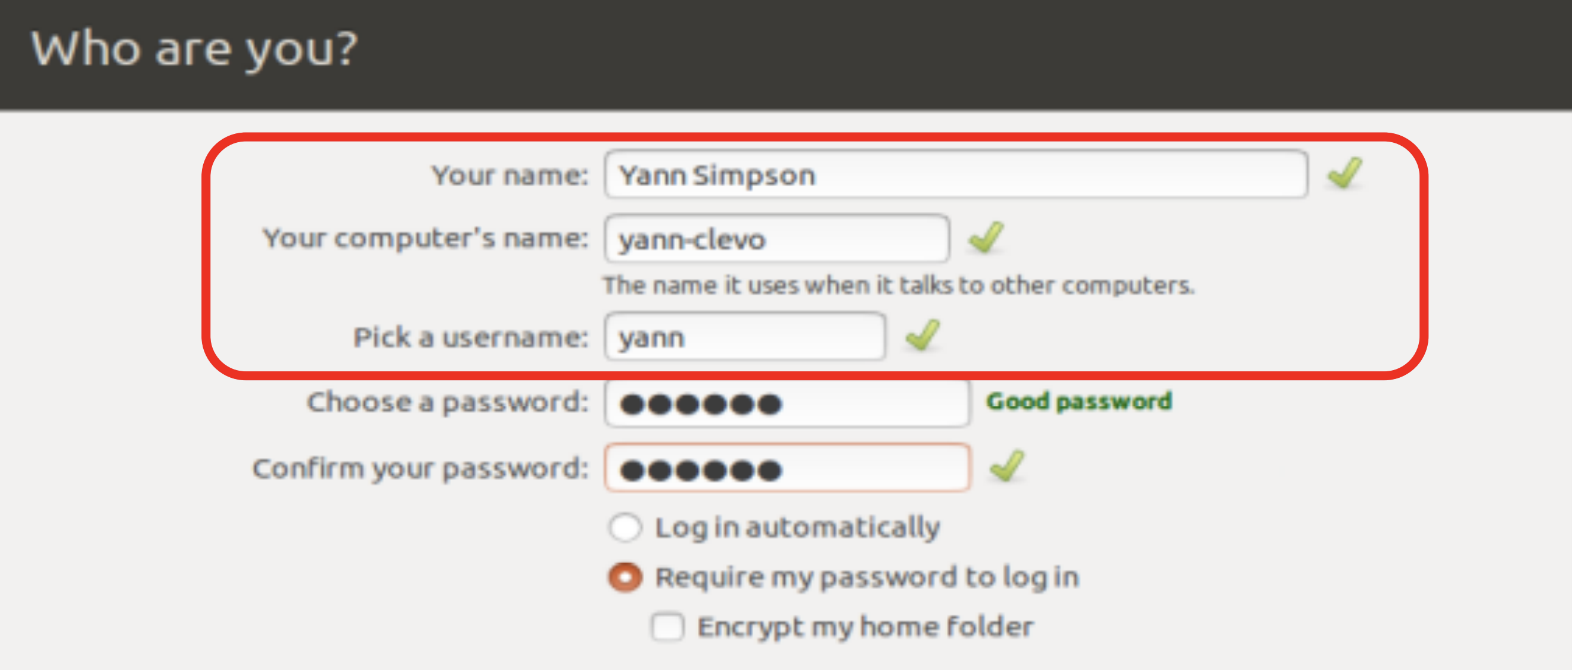
Username vs. Display Name

Slide 7
Disk Partitions
A disk partition is a way of dividing up a hard disk
Different partitions may contain different operating systems
Metadata about disk partitions is stored in the partition table

Slide 8
Log Files
Logs should be the first place you look when trying to figure out what has happened on a system
Figure out which logs are the most important for uncovering attacks, and where those logs are located
Note: During live analysis, logs may be overwritten accidentally!

Slide 9
File Metadata
Metadata = “data about data”
Two Types:
Structural – Data about the file content itself (file format)
Descriptive – Data about the context (creator, date created/modified)
Many tools/techniques for examining metadata
Simple Linux commands ( ls -l )
Autopsy
Exiftool (https://www.sno.phy.queensu.ca/~phil/exiftool/)

Slide 10
Live Analysis with VirtualBox
First, download and decompress victim raw disk image
Link provided in handout
> 8GB decompressed, so make sure you have the space!
In order to use the disk image in VirtualBox, we need to convert it to a VDI file:
$ VBoxManage convertdd disk.raw disk.vdi -format VDI

Slide 11
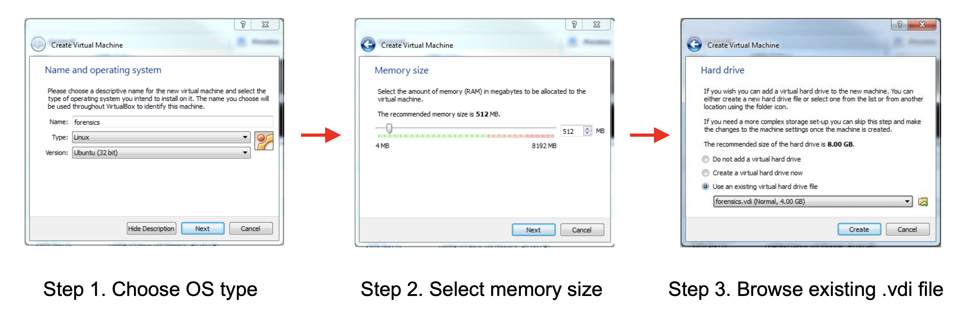
Live Analysis with VirtualBox

Slide 12
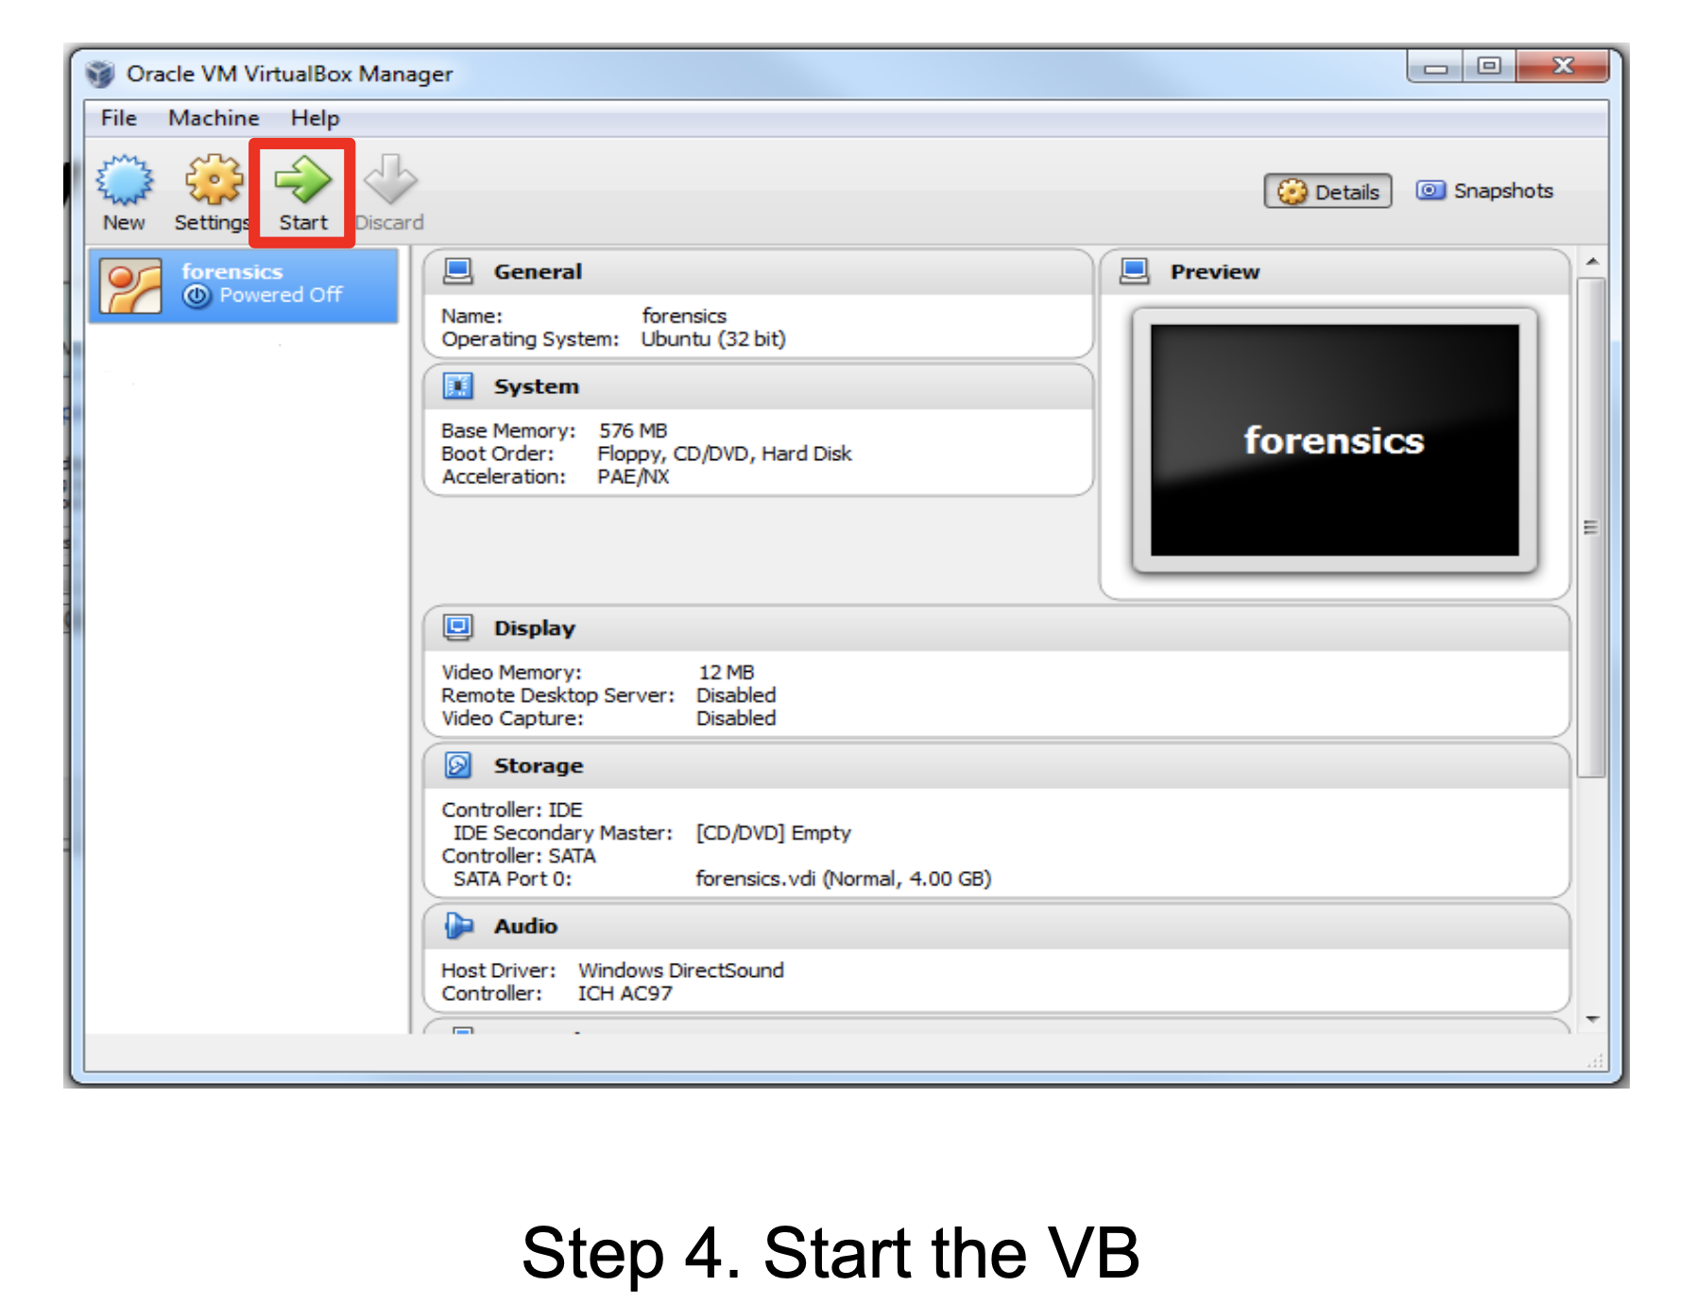
Live Analysis with VirtualBox

Slide 13
Intro to Autopsy
Autopsy is a state-of-the-art tool for dead analysis of disk images
Download: https://www.sleuthkit.org/autopsy/download.php
Make sure you get Autopsy version 4 or higher!
Recommended to run on Windows if possible (seems more stable), but should work on OS X and Linux as well

Slide 14
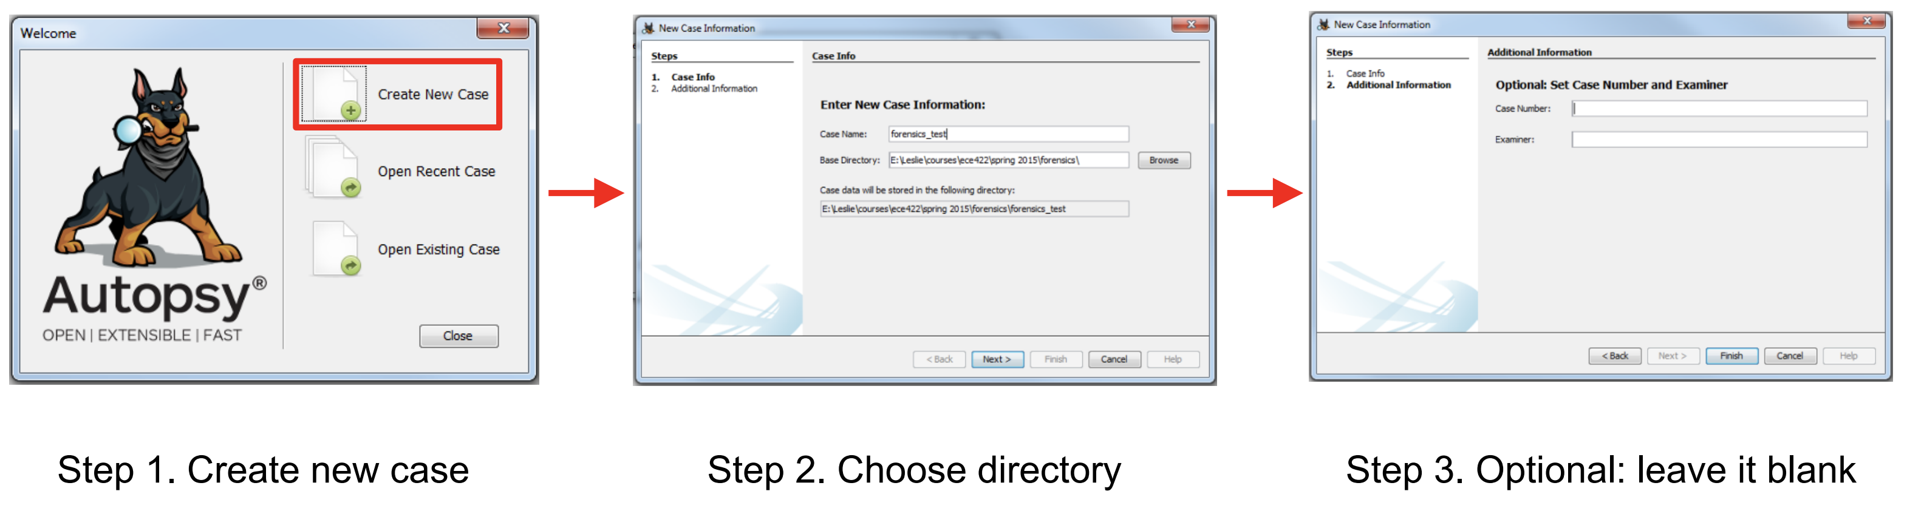
Intro to Autopsy

Slide 15
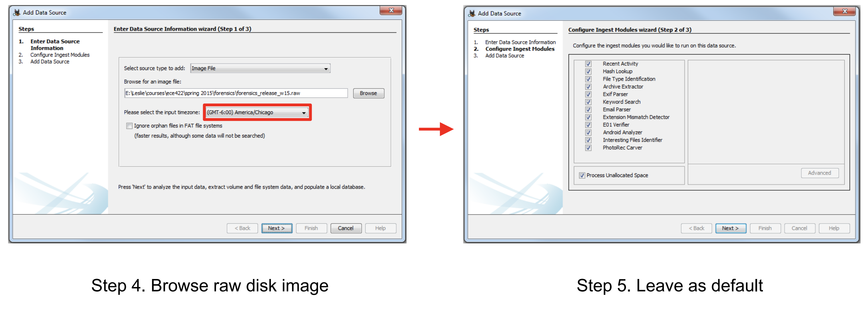
Intro to Autopsy

Slide 16
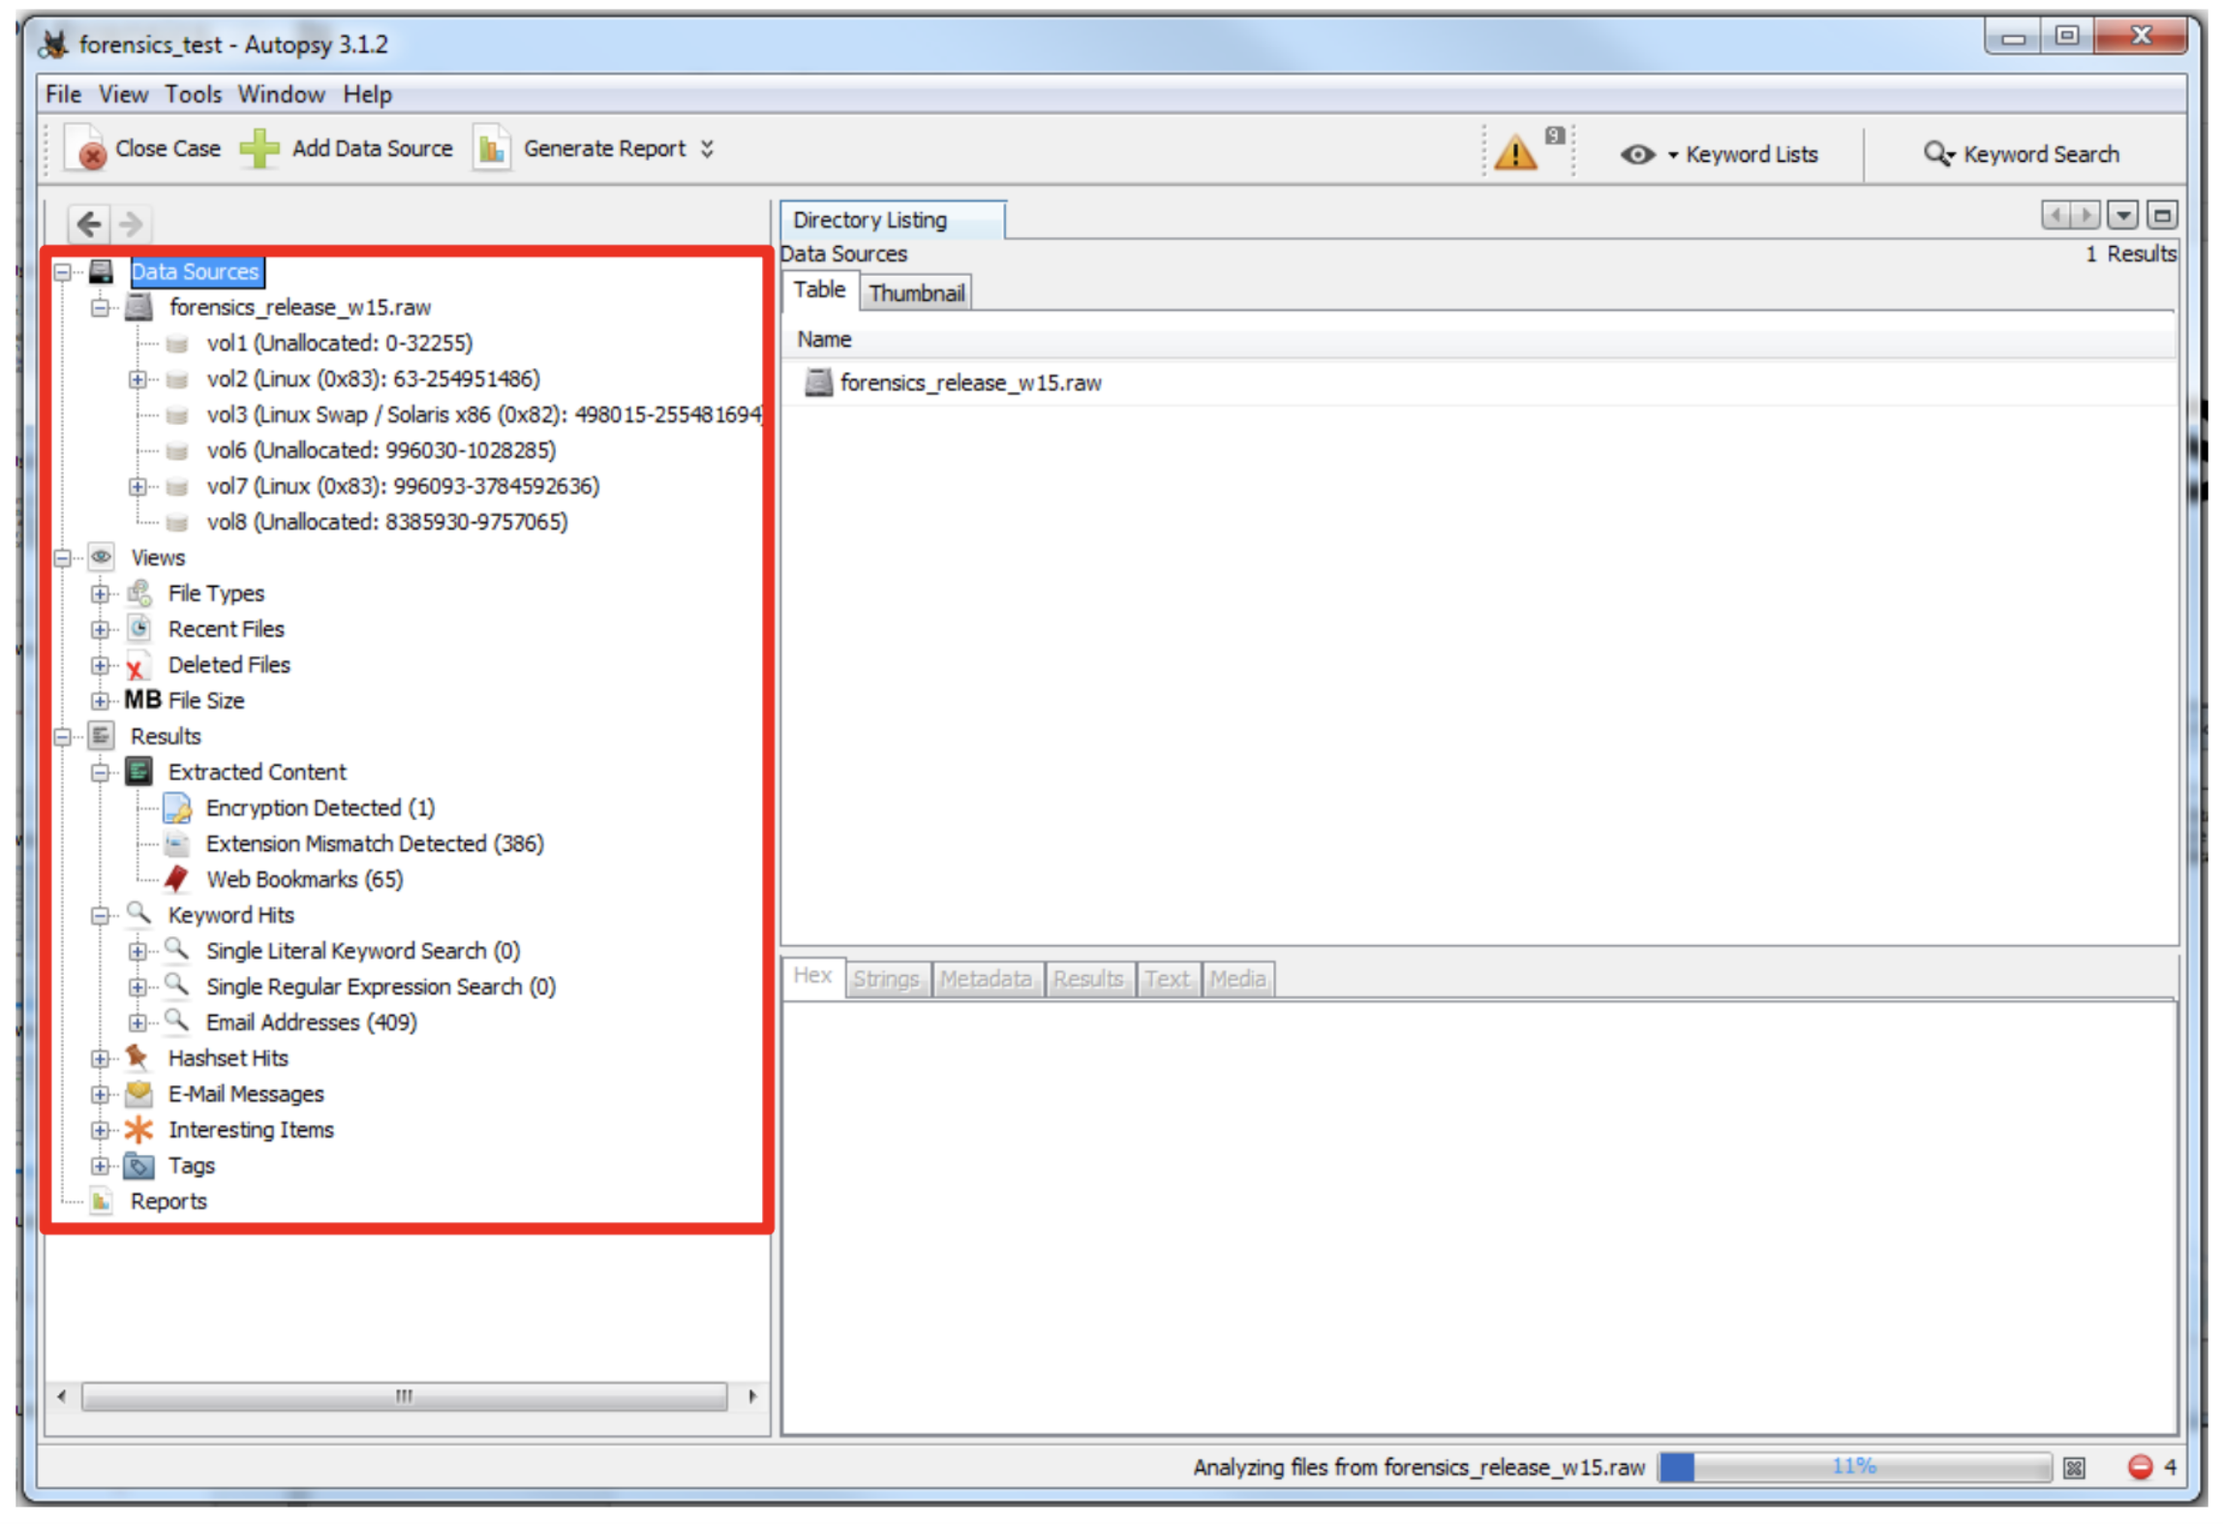
Intro to Autopsy

Slide 17
Other Tips
Attacker Mindset – What would you do if you were the attacker?
Look for deleted or encrypted files
Examine metadata of relevant files
Use the keyword search feature of Autopsy

